Slide 1

Frito Lay Presentation
Damilola Owolabi
DS 6306
Notes:
Steven Williams – CEO
Christy Jacoby - CFO

Slide 2
Agenda
Introduction
EDA
Objective 1: Regression Model
Objective 2: Classification Model
Conclusion

Slide 3
Introduction
Talent Dataset from DDSAnalytics
870 random Employees, 34 factors, 2 variables of interestt
No Missing values in the Dataset
Variables of Interest are
Regression: Salary of the employees
Classification: Turnover Rate of Employees
Random 70/30 split

Slide 4
EDA

Slide 5
Summary Statistics - Numeric
Variable Name | Min | 1st Quartile | Median | Mean | 3rd Quartile | Max
ID | 1.0 | 218.2 | 435.5 | 435.5 | 652.8 | 870.0
Age | 18.00 | 30.00 | 35.00 | 36.83 | 43.00 | 60.00
DailyRate | 103 | 472.5 | 817.5 | 815.2 | 1165.8 | 1499
Standard Hours | 80 | 80 | 80 | 80 | 80 | 80
PerformanceRating | 3 | 3 | 3 | 3.152 | 3 | 4
EmployeeCount | 1 | 1 | 1 | 1 | 1 | 1
StockOptionLevel | 0 | 0 | 1 | 0.7839 | 1 | 3
TotalWorkingYears | 0 | 6 | 10 | 11.05 | 15 | 40
JobLevel | 1 | 1 | 2.039 | 5,167 | 3 | 5
JobInvolvement | 1 | 2 | 3 | 2.732 | 3 | 4
Monthly Income | 1081 | 2840 | 4946 | 6390 | 8182 | 19999

Slide 6
Summary Statistics - Categorical
Variable Name | Num Categories | Min Size | Max Size
BusinessTravel | 2 | 94 (Non-Travel) | 618 (Travel_Rarely)
Department | 3 | 35 (Human Resource) | 273 (Sales)
EducationField | 6 | 15 (Human Resources) | 358 (Life Sciences)
Gender | 2 | 354 (Female) | 516 (Male)
JobRole | 9 | 51 (Manager) | 200 (Sales Executive)
MaritalStatus | 3 | 191 (Divorced) | 410 (Married)
OverTime | 2 | 252 (Yes) | 618 (No)
Attrition | 2 | 140 (Yes) | 730 (No)

Slide 7
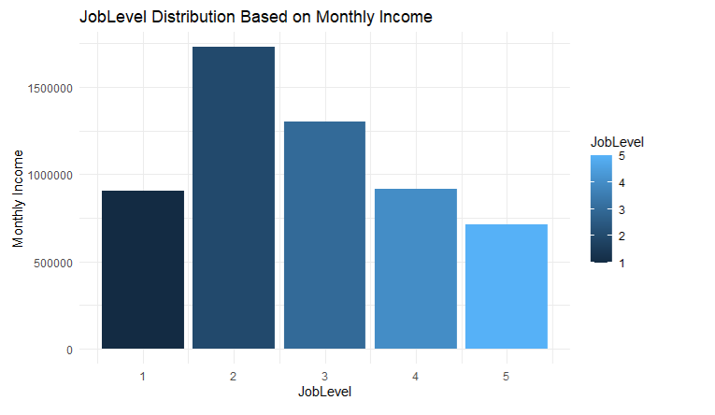
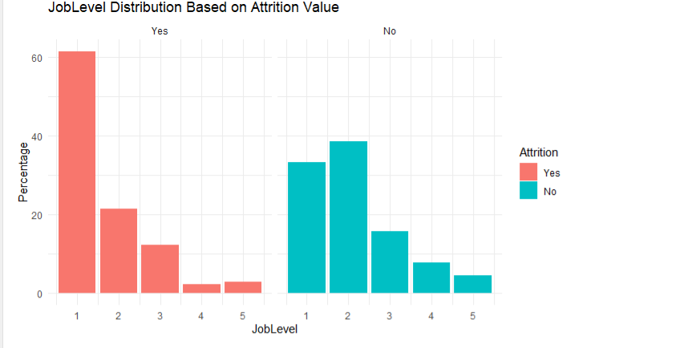
Job Level
Employees in Job Level 2 seems to be paid the best
There is a higher level of Employee turnover Rate among the employees in Job Level 1
There is a similar distribution overall between the monthly salary and employees that didn’t leave in terms of JobLevel.

Slide 8
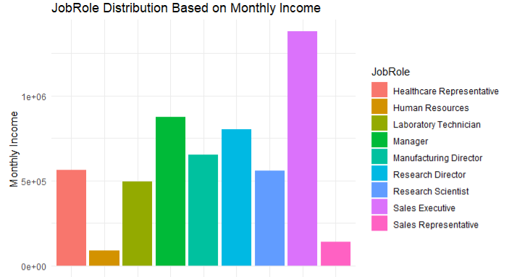
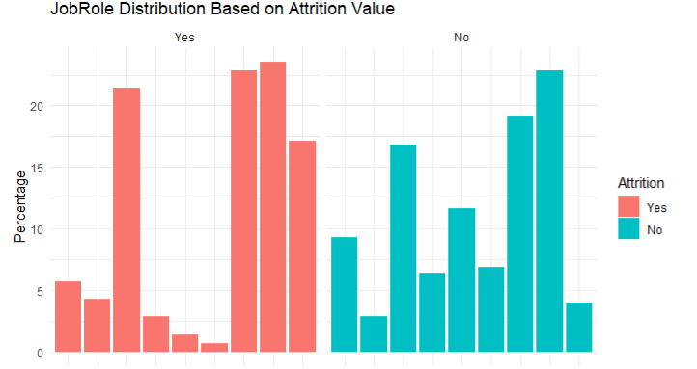
Job Role
Sales Executive seems to be the highest paid in the company.
There are similarities among the yes and no distributions.
Human Resources Employees seem to be the lowest paid

Slide 9
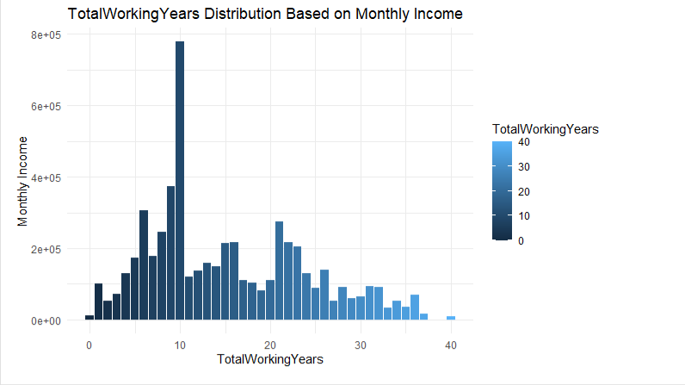
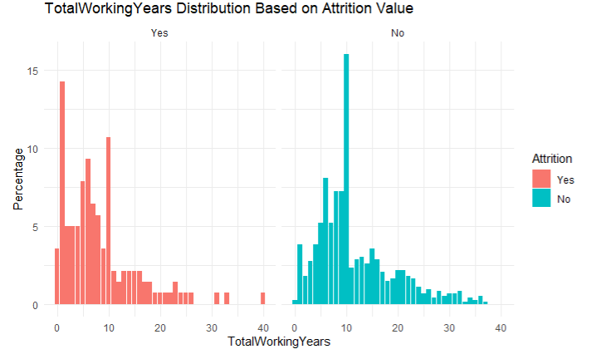
Total Working Years
The employees with around 10 years seem to be paid the highest.
There seems to be high turnover rate among employees with 10 years of in the company.
There seems to be a low turn over rate among employees with 1-3 years in the company.

Slide 10
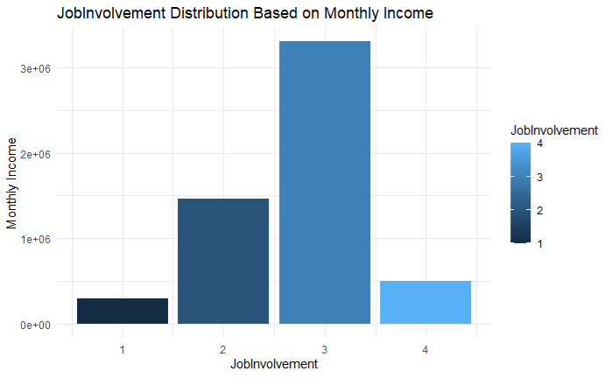
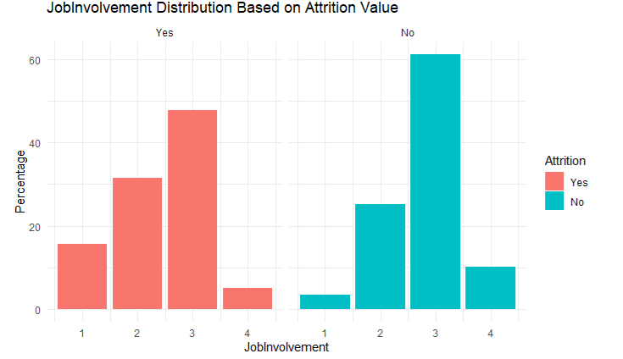
Job Involvement
Employees with Job involvement rate of 3 are the highest paid in the company.
There are similar distribution among the monthly income and the no attrition rates.

Slide 11
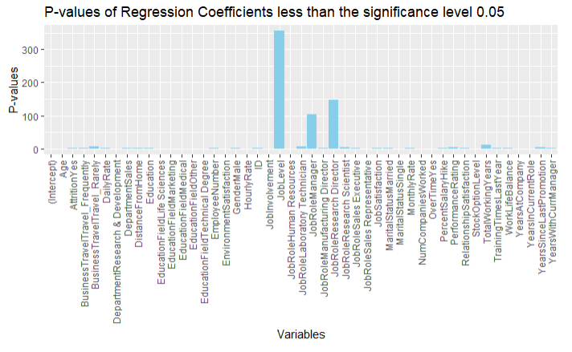
Pvalue Distribution based on Salary
Looking at the variables with the highest significance
From the plot above, we can see that the top 5 highly significant variables are
JobLevel
JobRole
TotalWorkingYears,
BusinessTravel
YearsSinceLastPromotion

Slide 12
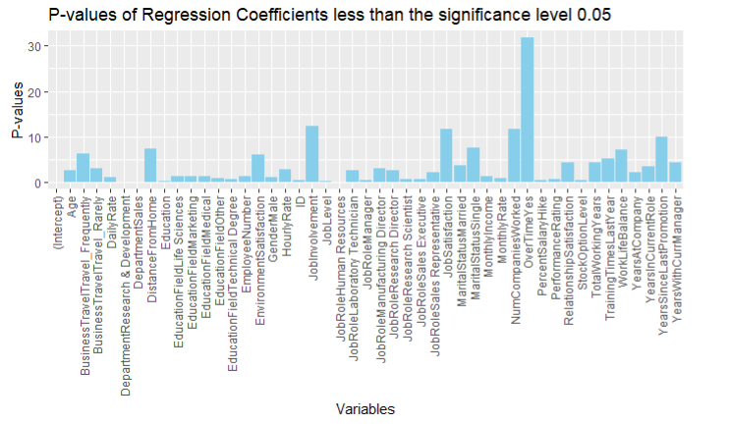
Pvalue Distribution based on Attrition
Looking at the variables with the highest significance
From the plot above, we can see that the top 5 highly significant variables are
OverTime
JobInvolvement
JobSatisfaction
NumCompaniesWorked
YearsSinceLastPromotion

Slide 13
Objective 1

Slide 14
Simple Model Creation (Classification )
Forward Variable Selection
CV using 10 folds
Tried to minimize mean RMSE (Root Mean Square Error)
MonthlyIncome ~ JobLevel + JobRole + Total_Working_Years
Variable | RMSE
(add) JobLevel | 1409.276
(add) JobRole | 1085.182
(add) Total Working Years | 1061.89

Slide 15
Objective 2

Slide 16
Simple Model Creation (Prediction)
Forward Variable Selection
Used numeric variables for better prediction.
CV using 10 folds
Tried to maximize mean AUC (Area Under the Curve)
Represents trade-off between sensitivity and specificity.
Attrition ~ JobLevel + JobRole + Total_Working_Years
Variable | AUC
(add) TotalWorkingYears | 0.6524
(add) StockOptionLevel | 0.6940
(add) JobInvolvement | 0.7157

Slide 17
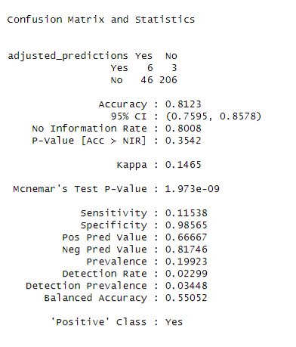
Naïve Bayes Model
Threshold for the F1 was 0.5726.
Specificity is 0.1154.
This is due to the low amount of Nos.
Sensitivity is 0.957
Accuracy is 0.5505
Pvalue is 1.94e-09 < sig level
Highly significant

Slide 18
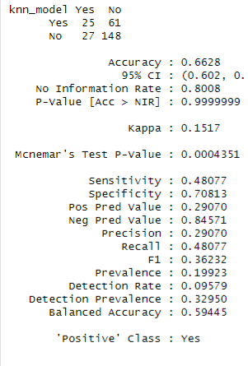
KNNModel
Used under-sampling to balance the Yes’ and No’s
Specificity is 0.7081.
Sensitivity is 0.4808
Accuracy is 0.5944
Pvalue is 4.4e-03 < sig level
Highly significant
KNN is the better model.

Slide 19
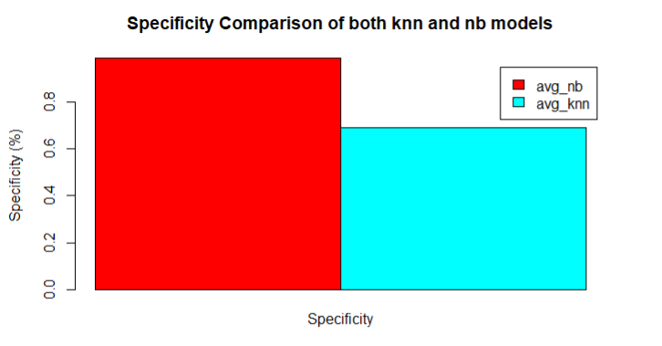
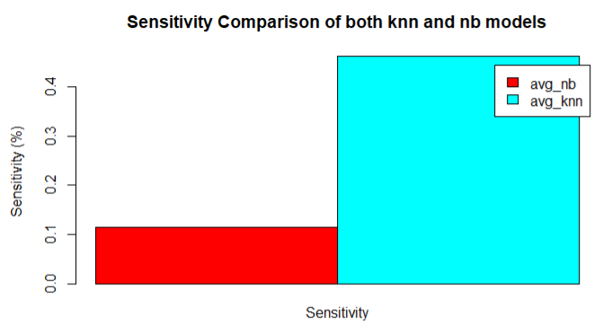
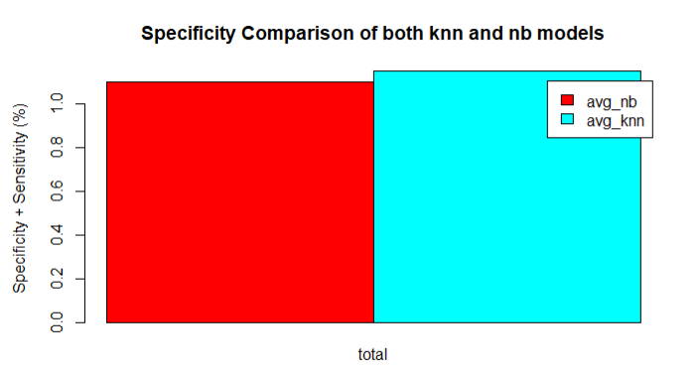
Metrics Comparison
Knn has a higher sensitivity and specificity + sensitivity.
Naïve Bayes has higher specificity.

Slide 20
Conclusions

Slide 21

Tips for Frito Lay
Try providing more incentives to employees to improve retention rate
Let the stock options match the amount of years the employees worked.
Notes:
Based on our analysis, We highly suggest For the next campaign, that the campaign team focus on the month of march, also look into the months of August and December.
PPl are more likely to say yes if the previously subscribed the previous time,
It'll more beneficial to call more when socio economic variables are low

Slide 22

Future Work
Try to improve sensitivity values for the classification model.
Explore other variables that might affect the classification and prediction model.
Try using other classification techniques to predict my model
SVM
RandomForest

Slide 23
Thank you!
Dammy Owolabi: oowolabi@smu.edu
Linkedin: linkedin.com/in/oluwadamilola-owolabi-ebenezer-345800137
Notes:
Thank you for your time, heres out linkedin if you will like to connect to ask more questions or reach out. We appreciate the time you took to listen tp our presentation. Have a wonderful day.

Slide 24
Backup slides

Slide 25
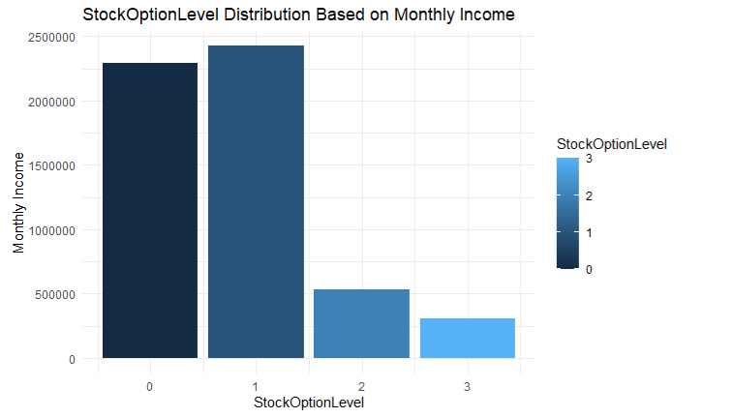
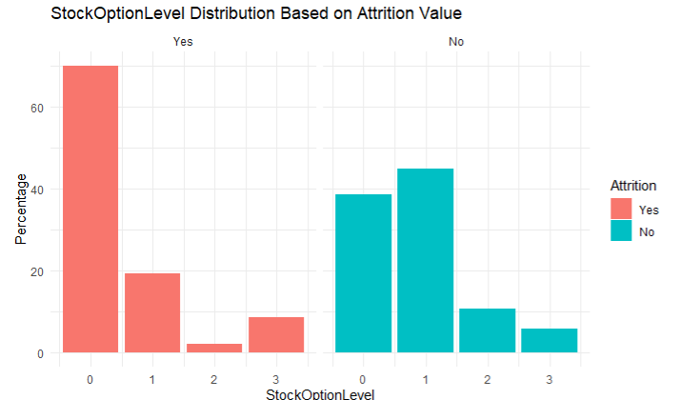
Stock Option Level
The employees with Stock option level 1 seem to have the highest monthly salary.
There seems to be a high turnover rate among employees with zero stock options level.

